Slide 7
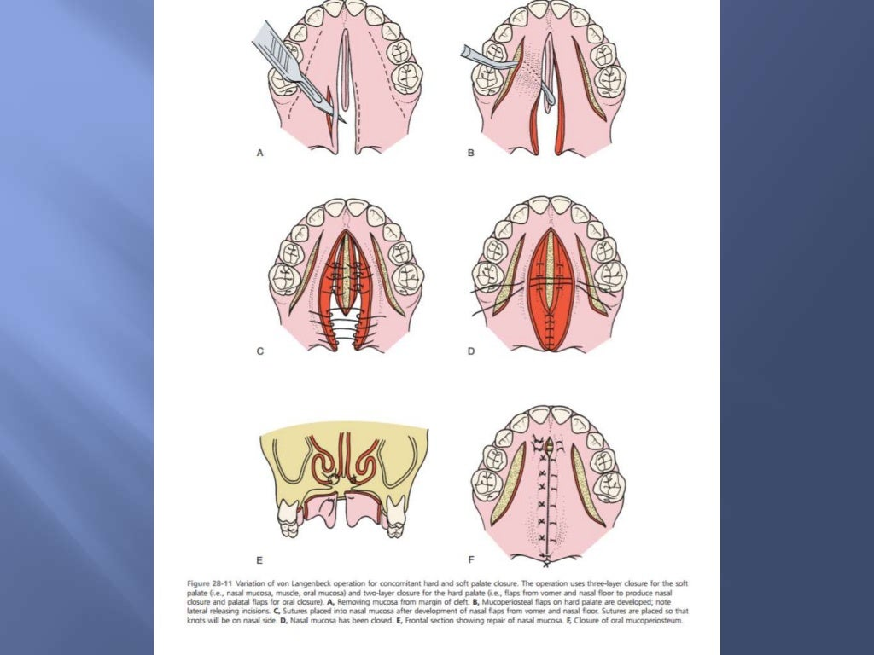

Slide 8
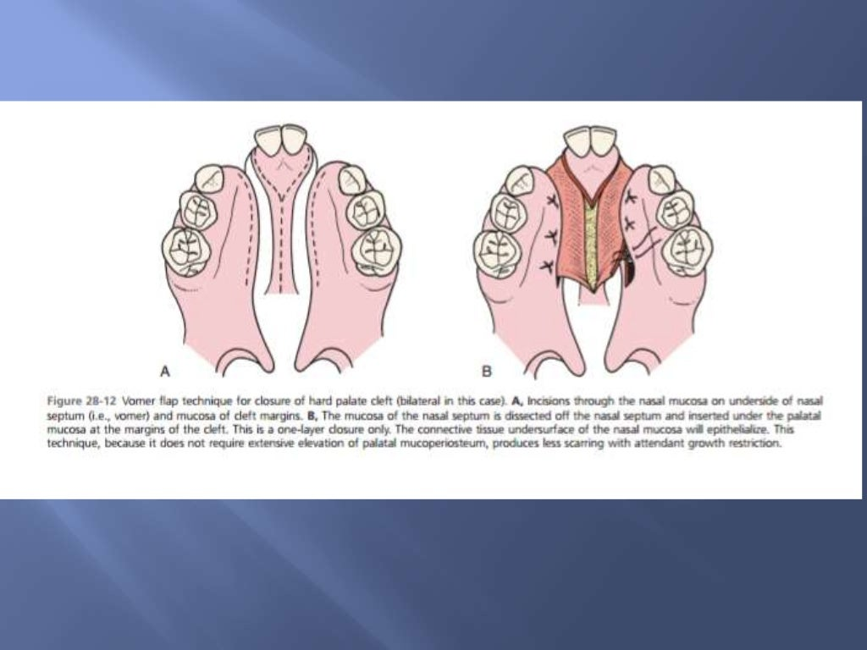

Slide 9
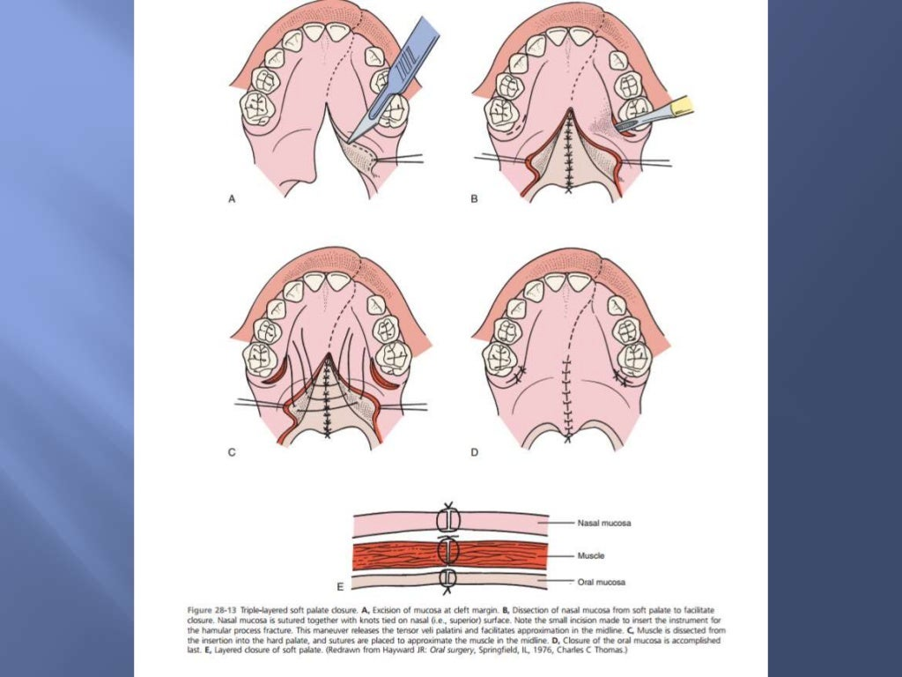

Slide 10
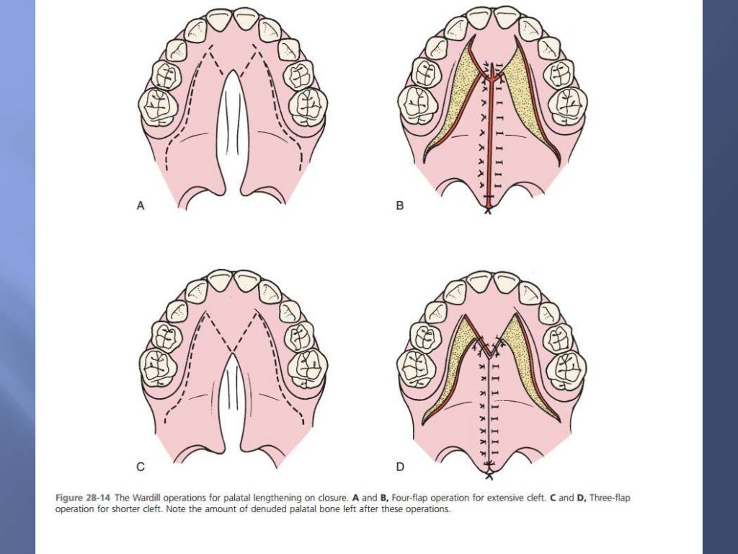

Slide 30
TAKE HOME MESSEGE
Cleft lip is congenital deformity of the upper lip that varies from a notching to a complete division of the lip , any degree of clefting can exist.
Cleft palate congenital split of the palate that may extends through uvula, soft palate and into hard palate, the lip may or maynot be involved in cleft of the palate.

